Slide 1
BAYES THEOREM

Slide 2
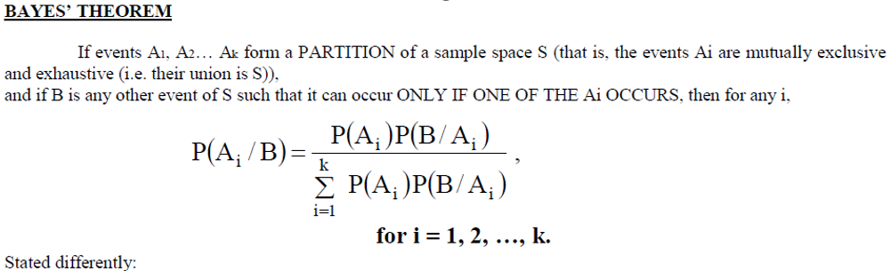
WHAT IS BAYE’S THEOREM

Slide 3
WHEN WE USE BAYE’S THEOREM?
suppose that a product was randomly selected and it is defective.
What is the probability that, this product was made by machine P,?
Questions of this type can lie answered by using the following theorem, called Bayes' rule

Slide 4
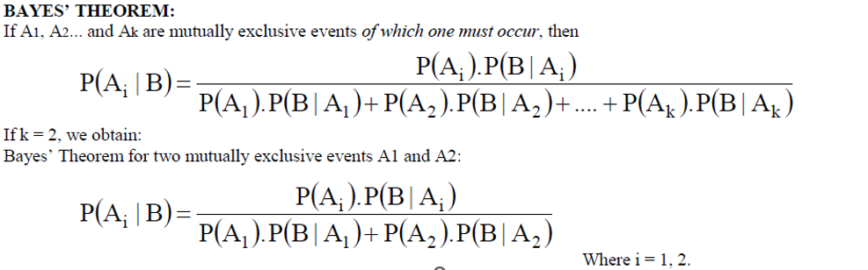
Formulas

Slide 5
Real Life Example
Bayes’ rule is used in various occasions including a medical testing for a rare disease.
With Bayes’ rule, we can estimate the probability of actually having the condition given the test coming out positive.
Besides certain circumstances, Bayes’ rule can be applied to our everyday life including dating and friendships.

Slide 6
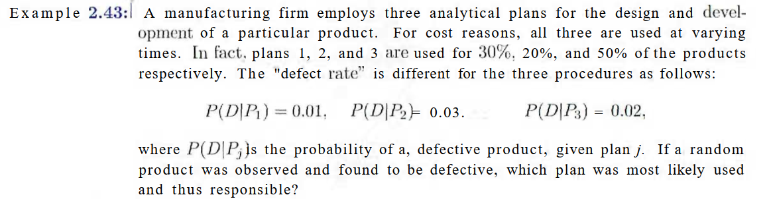
EXAMPLES

Slide 7
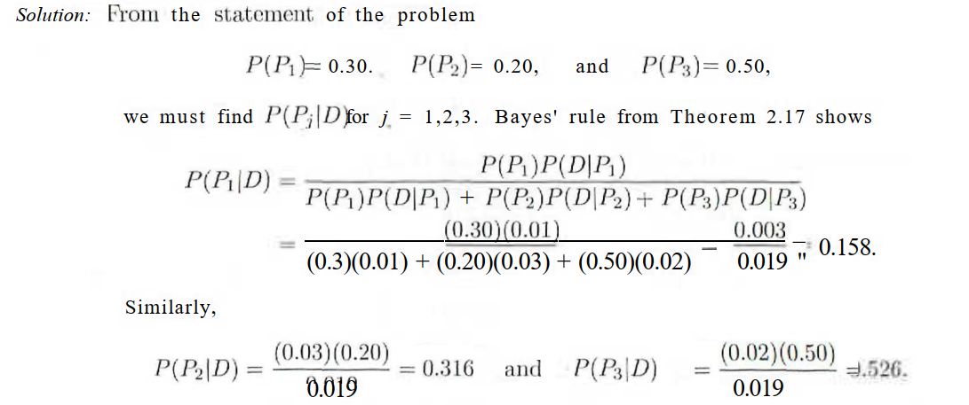

Slide 8
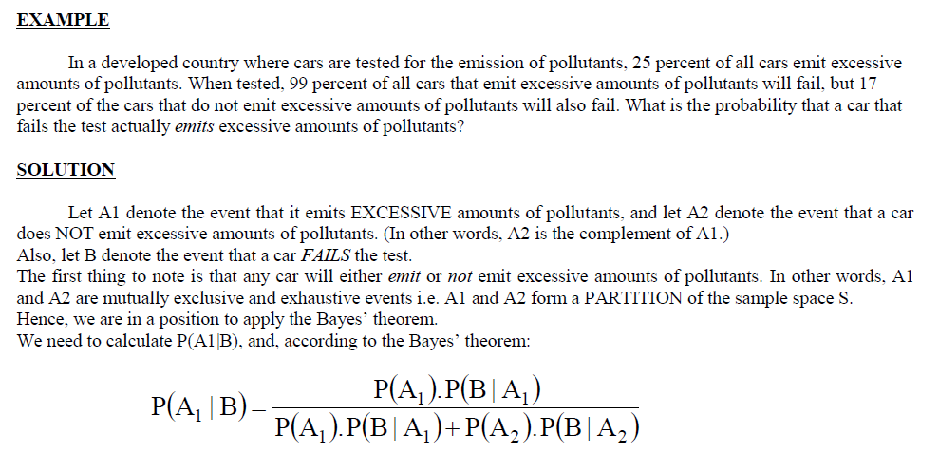

Slide 9
